Slide 1




INTERNSHIP PROJECT
BOOK RECOMMENDATION SYSTEM
AN INTELLIGENT BOOK RECOMMENDATION APPLICATION
Group - 3

Slide 2

Introduction
Overview:
The importance of recommendation systems in today’s digital world.
How the system enhances user experience by suggesting relevant books.
Key Features:
Personalized recommendations.
Multi-algorithm approach for better accuracy.

Slide 3


PROBLEM STATEMENT
Background:
The challenge of identifying books users may like from extensive libraries.
Limitations of traditional search and filtering methods.
Problem Statement:
Need for an intelligent, automated, and user-friendly recommendation system.

Slide 4
PROJECT OVERVIEW
Overview:
"The Book Recommendation System utilizes advanced algorithms to provide tailored book suggestions."
Algorithms Used:
Collaborative Filtering.
Association Rules.
K-Means Clustering.
KNN Algorithm

Slide 5



Objectives & Goals
Enhance user experience
Key Goals
To enhance user experience with personalized book recommendations.
Improve the efficiency of the book search process.
To Integrate multiple recommendation methods.
To ensure scalability and ease of use.

Slide 6





Technologies Used
Tools :
Google Colab is a cloud-based platform for running Python code with free GPU/TPU support and collaboration features.
Jupyter Notebook is an open-source tool for creating and sharing interactive documents with live code and visualizations.
Python :
Python is a high-level, versatile programming language known for its simplicity and readability. It is widely used in web development, data science, automation, artificial intelligence, and more.
Libraries & Frameworks :
Machine Learning: scikit-learn, mlxtend
Data Handling: pandas, numpy
Visualization: matplotlib, seaborn
Web Interface: Streamlit

Slide 7
ML Algorithms Used
A machine learning algorithm is a method or procedure that enables computers to learn patterns from data and make predictions or decisions without explicit programming. These algorithms power tasks like classification, regression, clustering, and recommendation systems.
Collaborative Filtering:
How it identifies user preferences based on similar users.
Association Rules:
Mining book pairings frequently purchased together.
K-Means Clustering:
Categorizing books into clusters for enhanced filtering.
K-Nearest Neighbors (KNN):
Suggests recommendations based on similarities in attributes like ratings, authors, or genres.

Slide 8
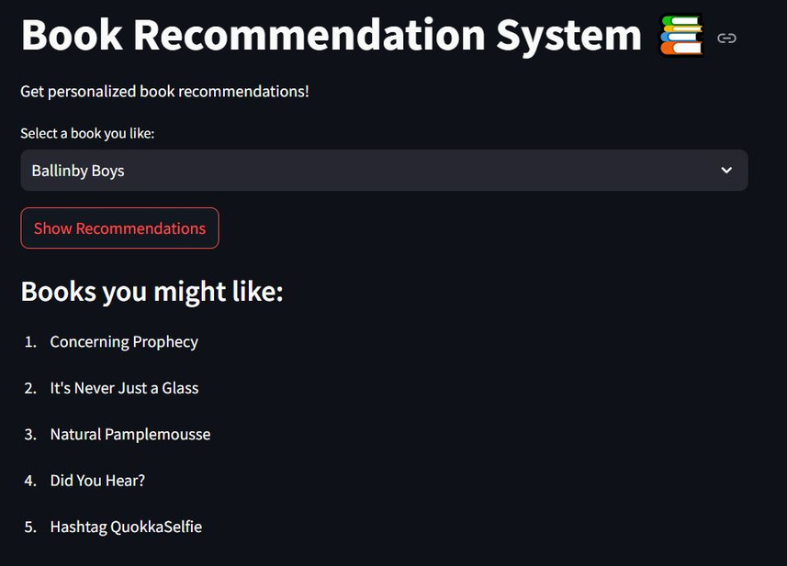
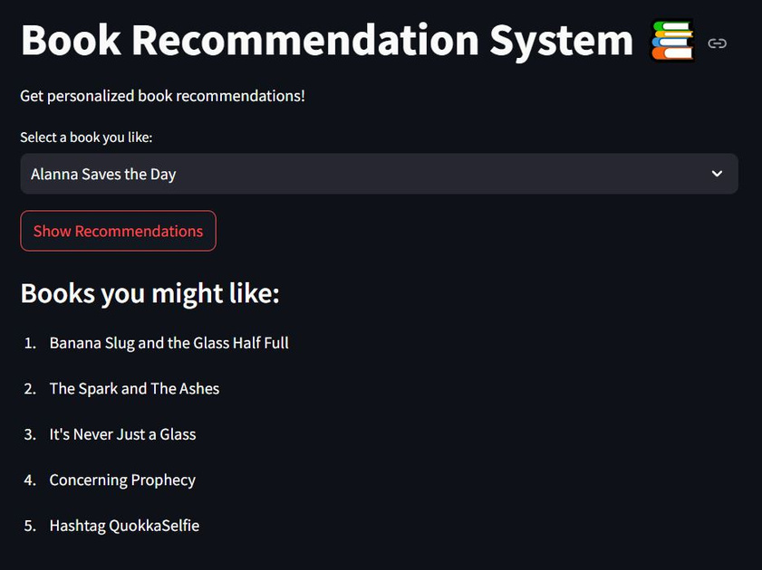
Results
OUTPUT 1
OUTPUT 2

Slide 9


Challenges & Limitations
Challenges:
Managing large datasets.
Ensuring accurate clustering and association rules.
Limitations:
Sparse data can impact collaborative filtering accuracy.
Association rules depend on sufficient transactional data.

Slide 10
Future Enhancements
Potential Additions
Integration
Can Include content-based filtering for hybrid recommendations.
Can Introduce user ratings and reviews for better predictions.
Can Expand datasets for improved scalability.
Deploy on platforms like websites and mobile apps.

Slide 11
CONCLUSION
In Conclusion : Recommendation systems elevate user satisfaction by delivering personalized suggestions, simplifying book discovery, and broadening reading choices. They create an engaging, seamless experience that encourages exploration and enjoyment.
In the publishing industry, these systems boost sales, highlight niche books, and provide data-driven insights into user preferences and trends. By targeting specific audiences, they foster loyalty and empower publishers to enhance engagement effectively.
This Book Recommendation System revolutionizes how readers connect with books, making discovery intuitive and enjoyable, while also driving growth in the publishing ecosystem.
"Transforming the way of finding books."

Slide 12

THANK YOU
For watching this presentation
9100632667 - Sruthi Vishnubhatla
8050660894 - Nikita Tambole
9390216477 - Y T SURYANARAYANA
7795288655 - Sohil Nadaf
9392763867 - Jhansysreenivas Manchuri
6309688579 - KODAVALI LIKITHA
6281037323 - K. Dharani chowdary

